Slide 1

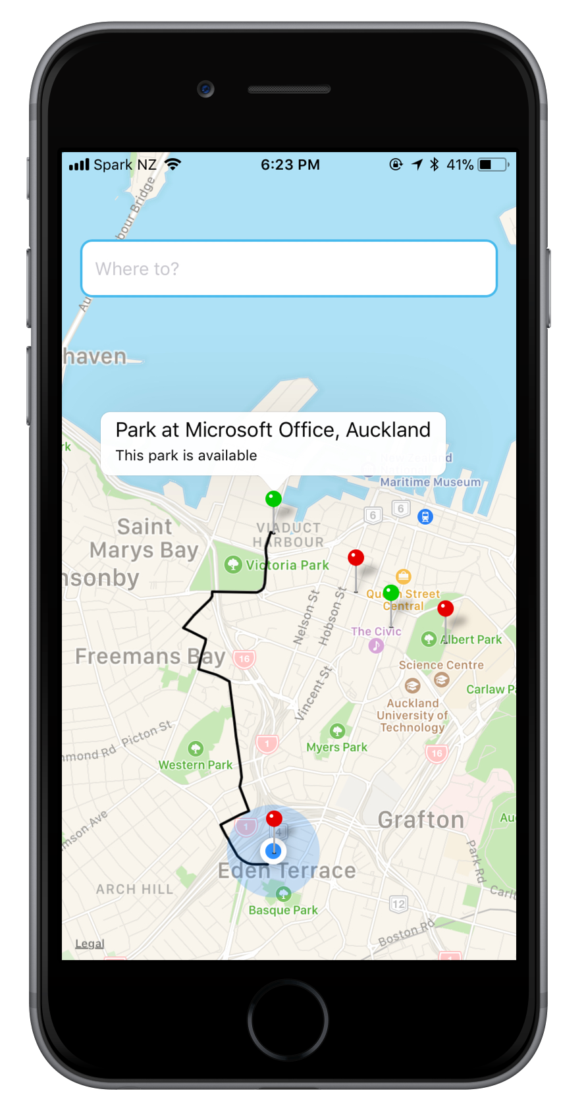

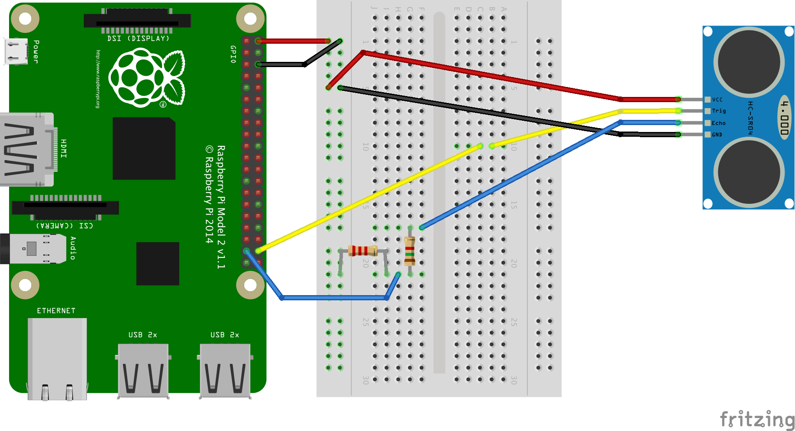




Hardware
Software
App Service
Patch Request, updates DB
Get Request, updates App
Easy API
Raspberry Pi + Ultrasonic Sensor
Easy Tables
(SQL Database)

